Slide 1
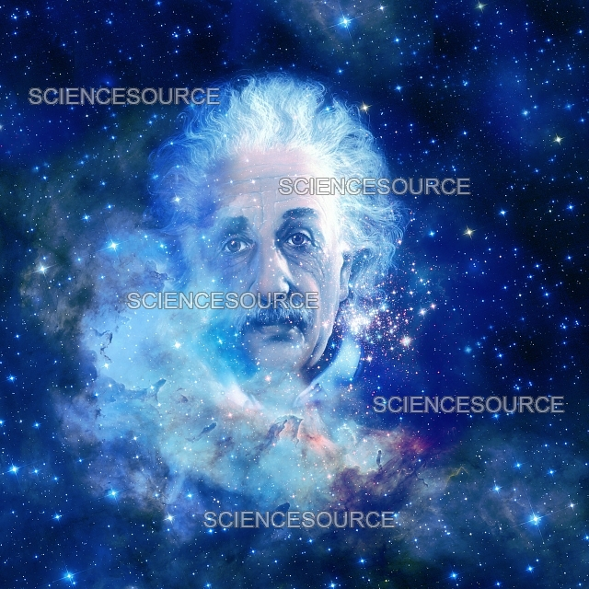
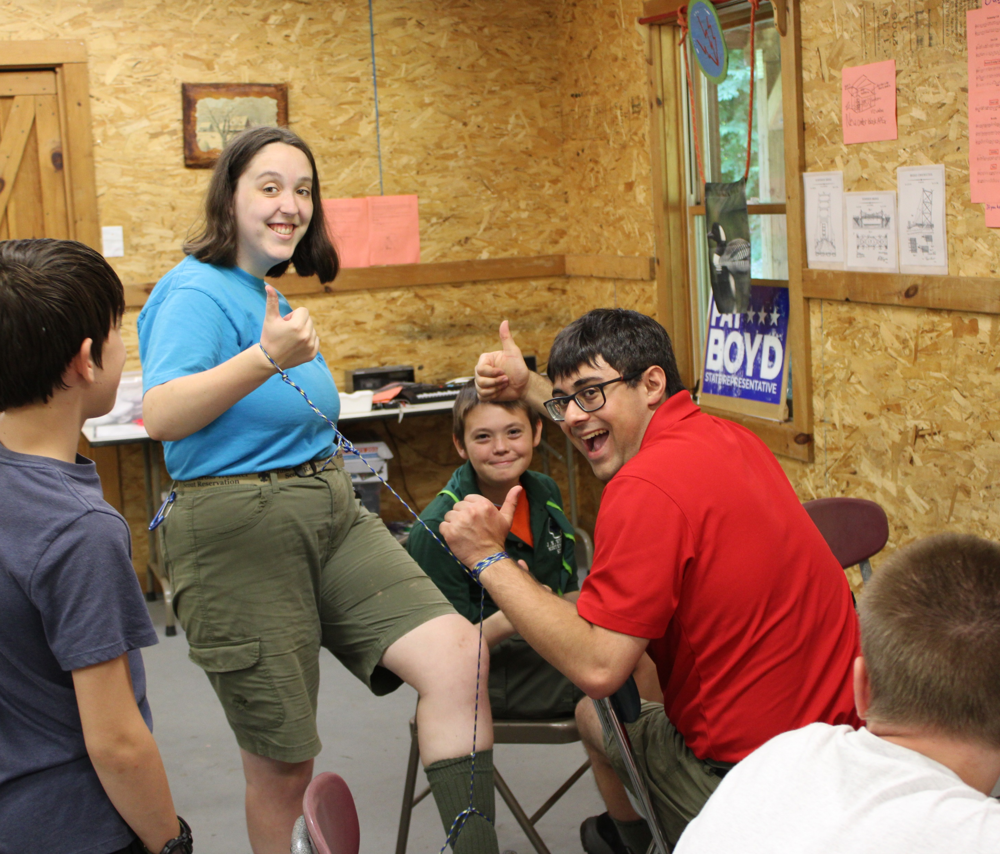
Space Exploation
!!!!!!!!!!!!!!!!!!!!!!!!!!!!!!!!!!!!!!!!!!!!!!!!!!

Slide 2
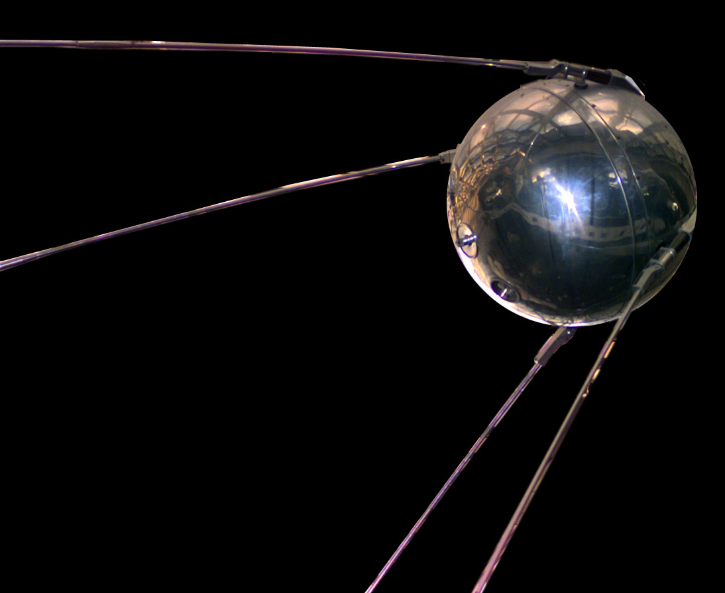

Slide 3
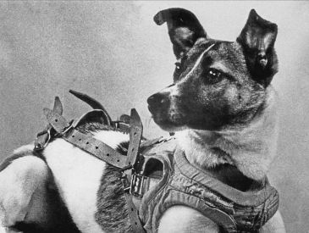

Slide 4
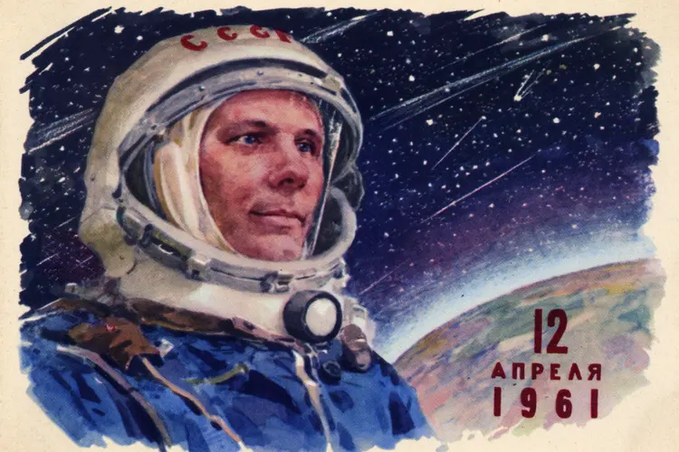
1

Slide 5
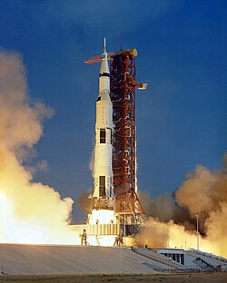
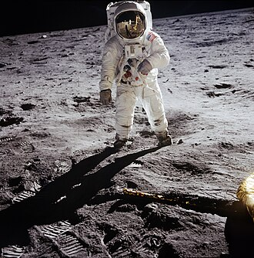
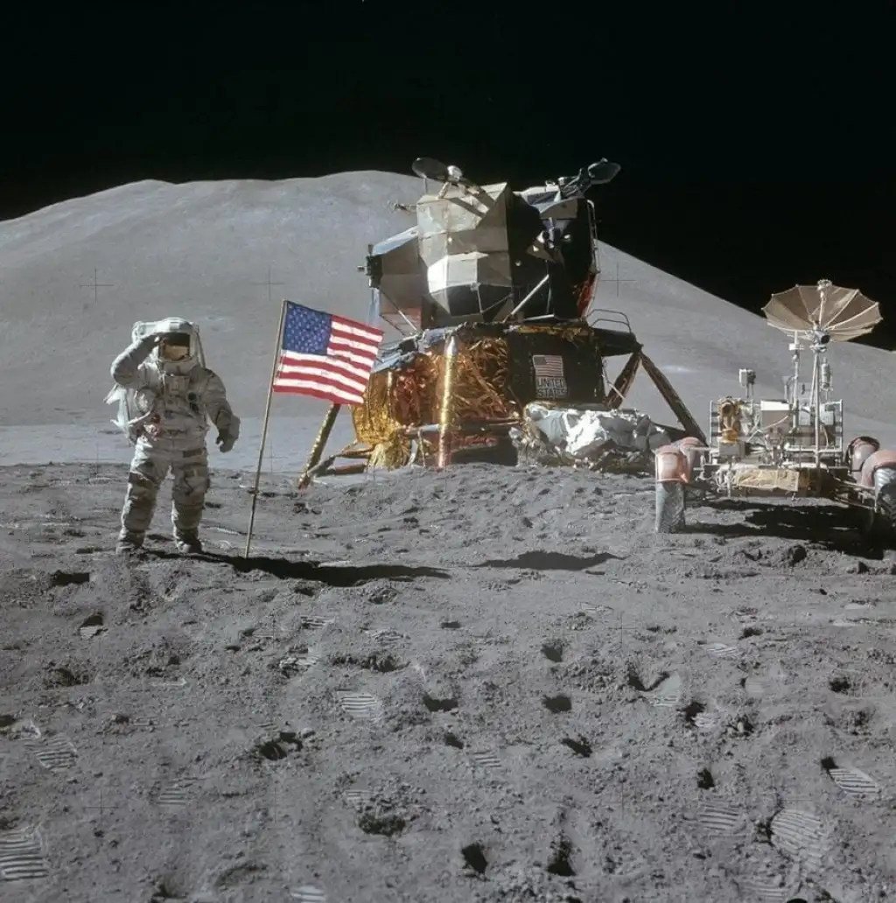

Slide 6
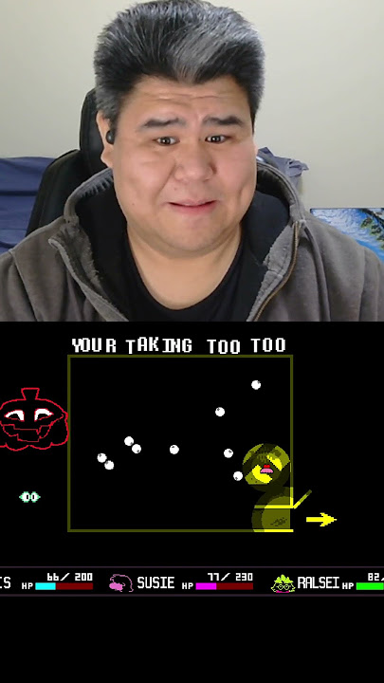
ENDINGGGG!!!!

Slide 7
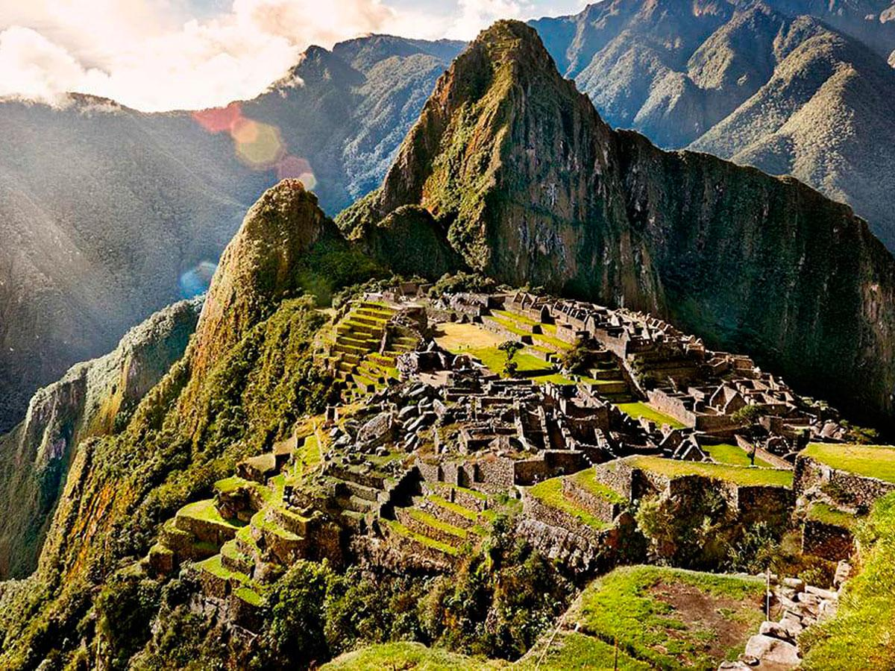
Collector’s Card of a Space Person!!!!!!!!!!
3 Fun Facts (Birthdays are not fun facts)
No Neil Armstrong (He’s too boring)
Real Person (No fictional people)
Person should be an astronaut, investor/space advocate, or scientist related to space or physics research.

Slide 8
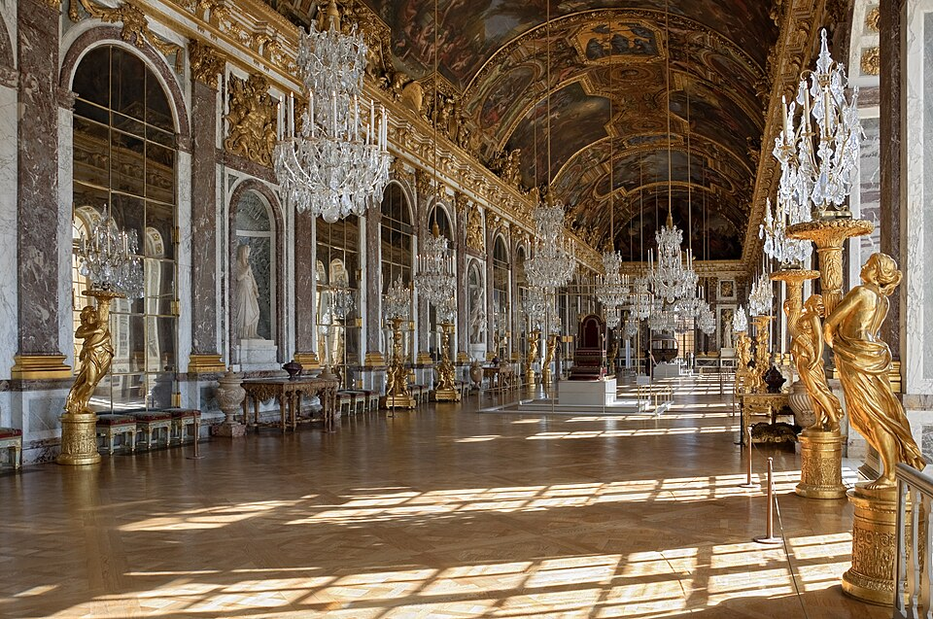
Space Base

Slide 9
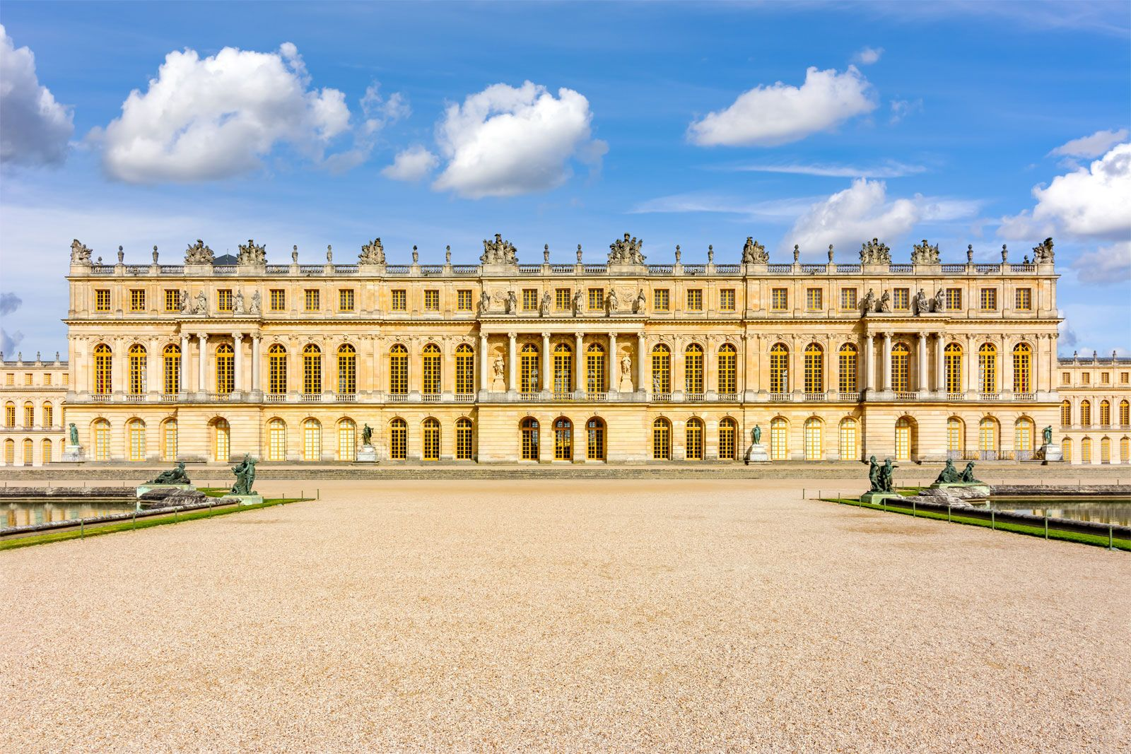
Robot

